Slide 1


Slide 2
GROUP MEMBERS
HABIB AHMED
21-ARID-571
ASADULLAH
21-ARID-559
MOBASHIR ALI
21-ARID-598

Slide 3
PROJECT TITLE
BLOGGER POST AND SERVICE

Slide 4
TECHNOLOGIES USED
FRONTEND
HTML
CSS
JAVASCRIPT
JQUERY
BOOTSTRAP FRAMEWORK
BACKEND
PHP

Slide 5
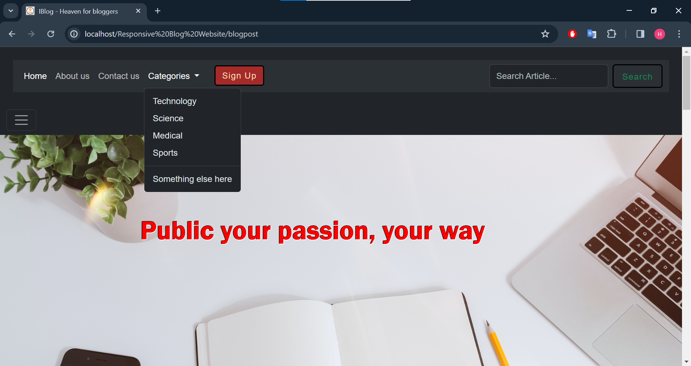
FRONTEND SCREENSHOTS Navigation bar

Slide 6
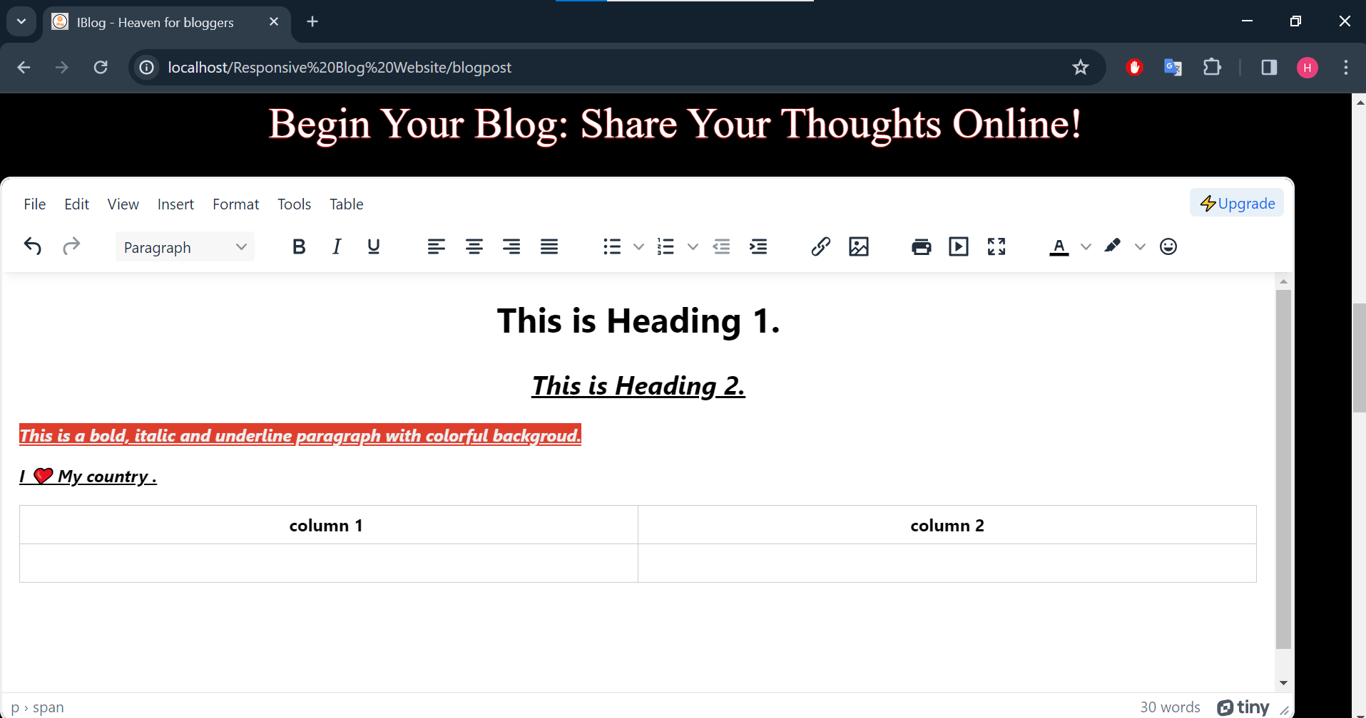
Text Editor For writing the Articles

Slide 7
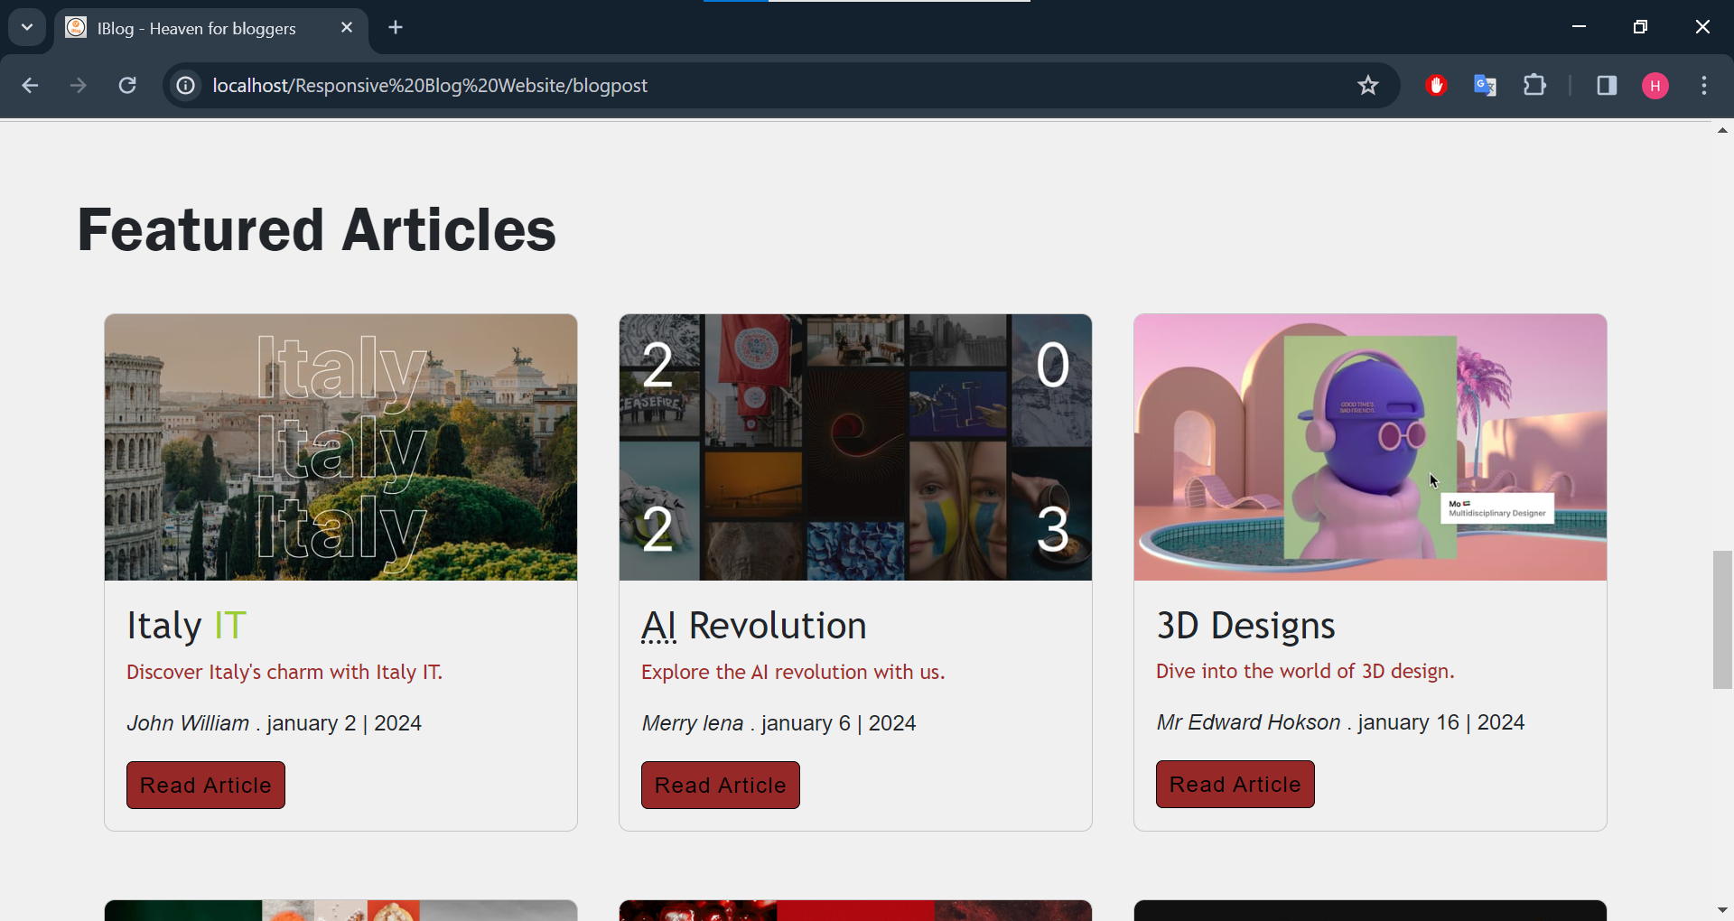
Cards for Reading the Blogs

Slide 8
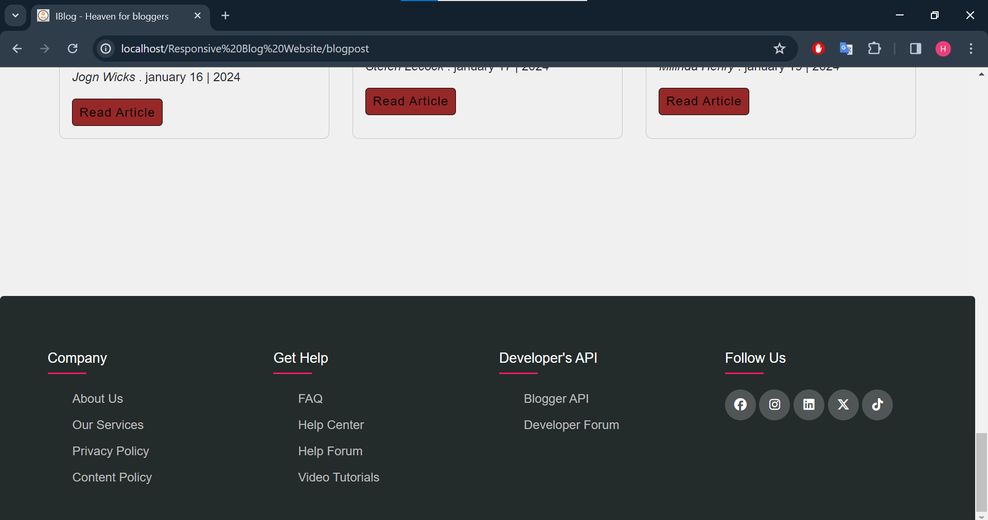
Footer links

Slide 9
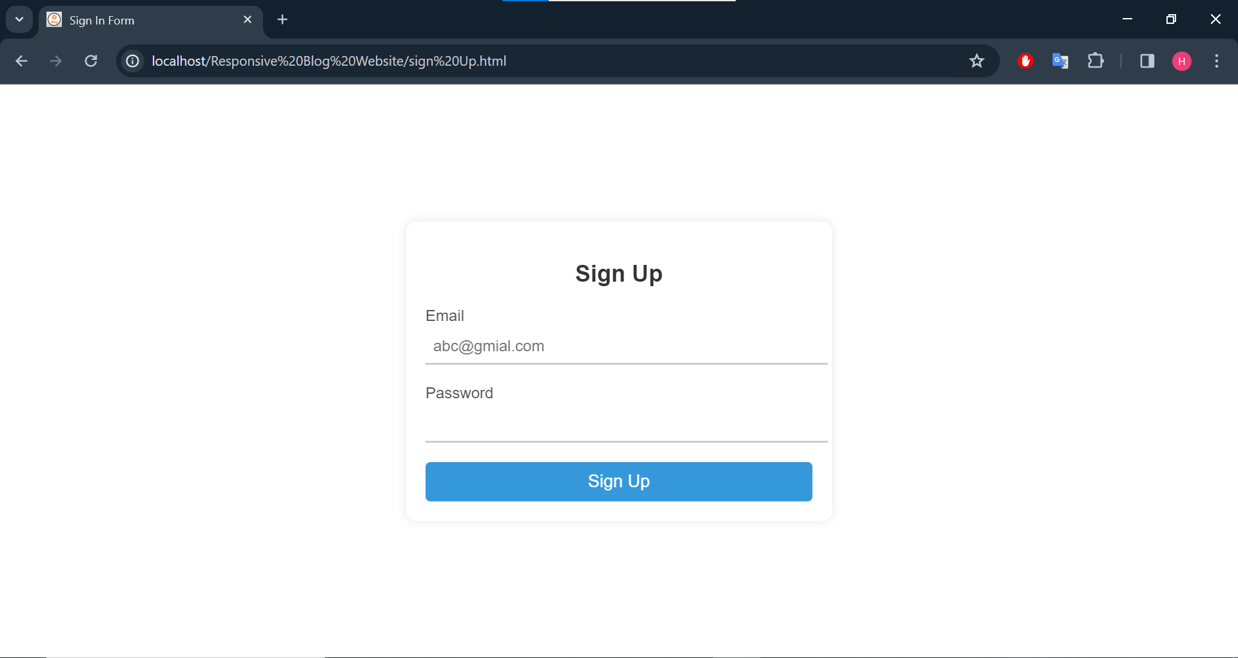
Sign Up Form

Slide 10
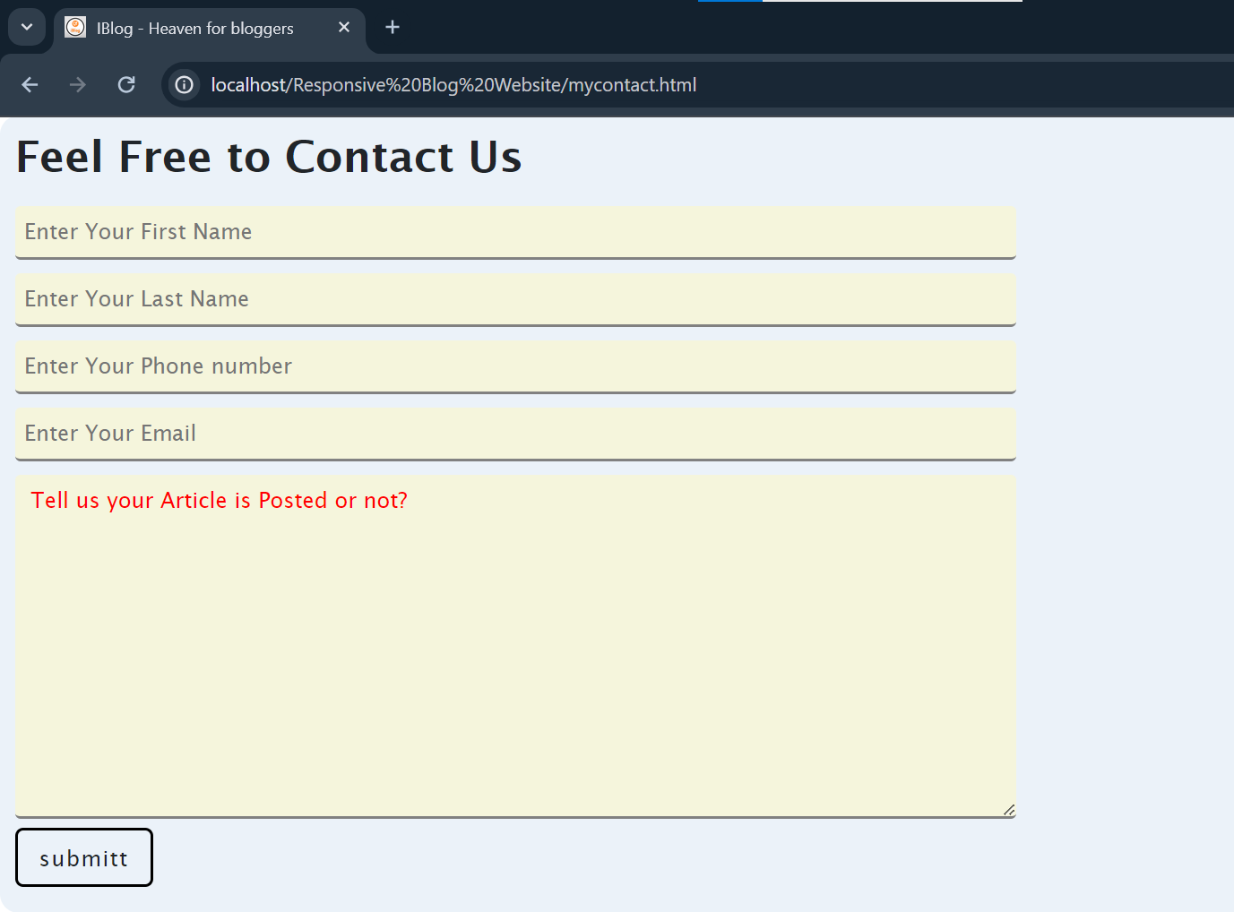
Contact Us Form

Slide 11
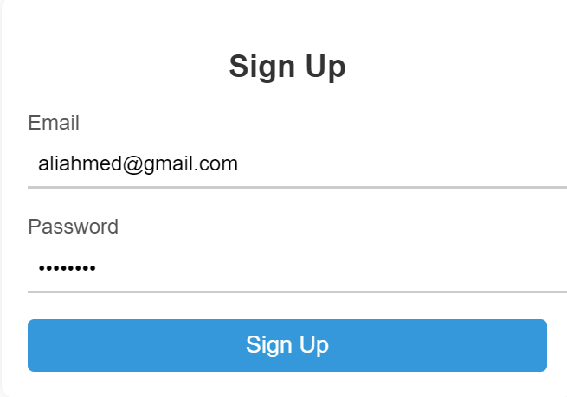
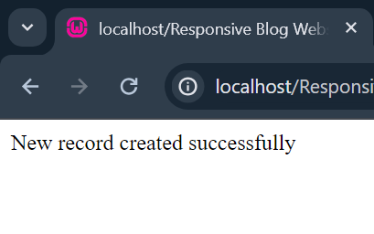
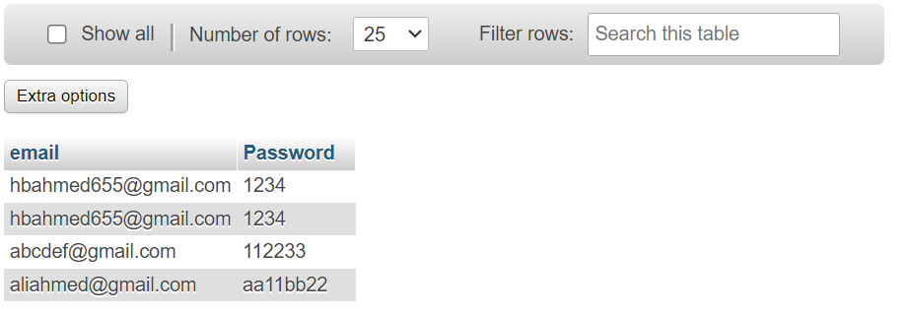
Backend ScreenShots Sign Up Form

Slide 12
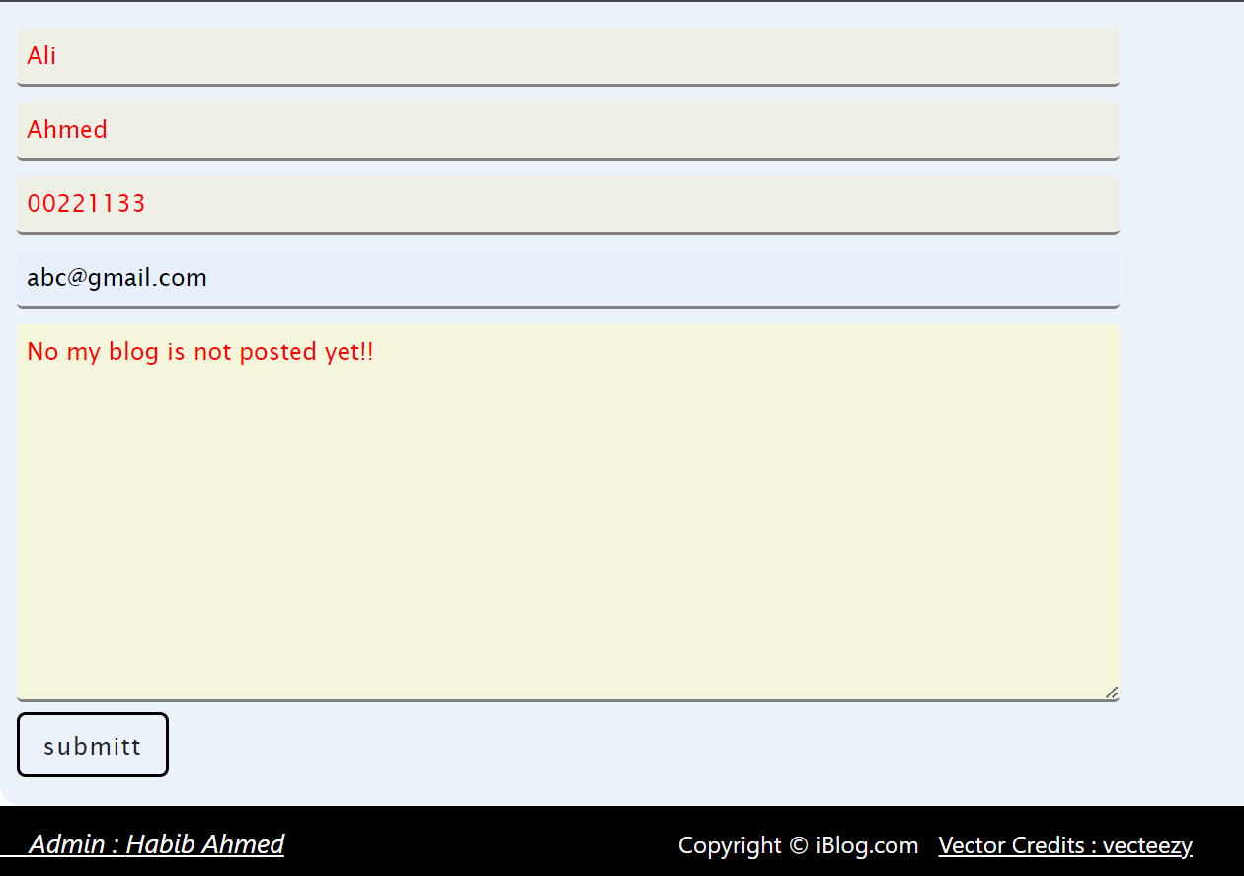
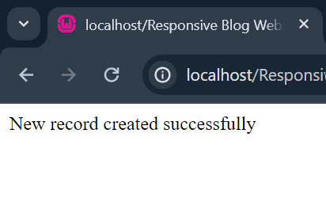
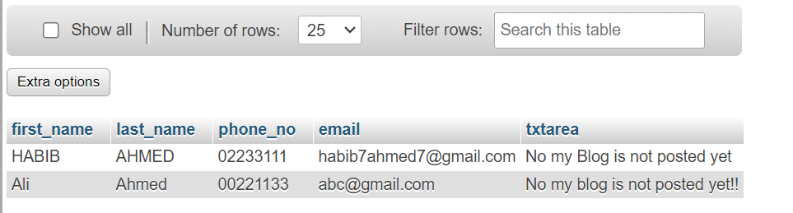
Contact Us form database Record

